Slide 1
Async Everywhere!
Troy .NET User Group, August 2017
Notes:
Questions welcome!

Slide 2

Who is this guy?

Slide 3


Slide 4


Notes:
Everyone from Northern Michigan says they’re from Northern Michigan, not just “Michigan”.

Slide 5


Slide 6
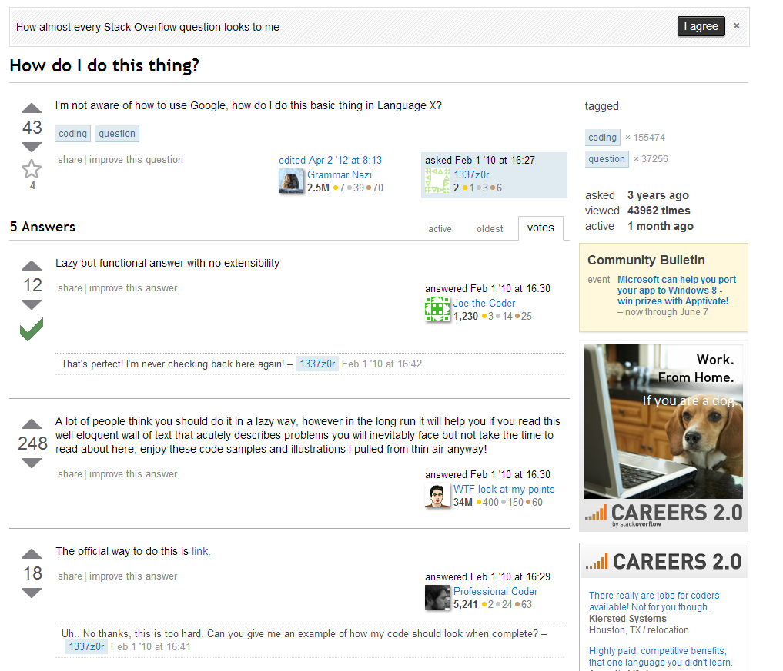
Notes:
I’m the “async guy” on Stack Overflow.
Not Jon Skeet.
Also have a blog (mostly async these days).
Regular developer, not a travel-the-world elite speaker.

Slide 7


Slide 8
Async Syntax

Slide 9
Introduction to Async
async Task DoNothingAsync()
{
// In the Real World, we would actually do something...
await Task.Delay(100);
}
The async keyword:
Enables the await keyword for that method.
Transforms the method into a state machine, similar to the yield keyword.
That’s it!
Notes:
The async keyword can only be applied to a method.
Details of the transformation are not important; just be aware that there is a transformation going on.

Slide 10
Introduction to Async
async Task DoNothingAsync()
{
// In the Real World, we would actually do something...
await Task.Delay(100);
}
async Task DoNothingAsync()
{
Task delay = Task.Delay(100);
await delay;
}
await
Takes a single argument.
“Awaitable”
Usually a Task or Task<T>.
Notes:
“Await” is like a unary operator; it takes a single argument (like a cast).
This argument is an “awaitable”. I won’t get into the specifics, but an “awaitable” is a type that matches a certain pattern (similar to how foreach works).
An “awaitable” represents an asynchronous operation. In this talk, all our “awaitables” are Task objects.
Technically, you don’t “await” a method; you call the method and then “await” the Task it returns. But “await a method” and “awaitable method” are common phrases.
- Another method can await the task returned from DoNothingAsync, not b/c the method is async, but b/c it returns a Task.
Async methods start synchronously; so this method will (synchronously) call Task.Delay and then await.
Await is where things can start to get asynchronous.

Slide 11
Introduction to Async
async Task DoNothingAsync()
{
// In the Real World, we would actually do something...
await Task.Delay(100);
}
await behavior:
If awaitable (task) is complete, continues synchronously.
Otherwise:
Pauses the method and registers it with the awaitable.
Then returns.
Notes:
The “registering” is saying, “when you complete, please resume this method”.
When DoNothingAsync returns, it returns an incomplete Task.
This Task is completed when the DoNothingAsync completes (end of method or “return” statement).

Slide 12
Introduction to Async
async Task DoNothingAsync()
{
// In the Real World, we would actually do something...
await Task.Delay(100);
}
Pausing and Resuming (when awaiting tasks)
A “context” is captured and used to resume.
UI thread, ASP.NET request, thread pool.
Actually current SynchronizationContext or TaskScheduler.
Notes:
In ASP.NET the “context” is the request context (HttpContext.Current, identity, and culture).
In this example, if you have the request context before the await, then you’ll have it after the await.
Request context only allows one thread at a time.

Slide 13
Introduction to Async
The async keyword creates (and returns) a task for you.
What the task means:
Represents the execution of the method.
When the method completes, the task is completed.
Contains the result of the method (including exceptions).
Return statements complete the task (returned value becomes the task’s result).
Exceptions fault the task (captured and placed on the task).

Slide 14
But Why?

Slide 15
The Async Revolution
Notes:
The async/await keywords are taking over the world!
Many people (like me) see this as a good thing.
Generally, people who have done asynchronous programming in the past welcome async/await.

Slide 16
The Async Revolution Invasion?
Notes:
But maybe that doesn’t apply to you (and that’s OK!).
Those who have not worked with asynchronous code before view async/await as problematic.
Async/await have a tendency to “infect” code, and if you’re new to asynchronous programming, it seems more like an invasion than a revolution.
Part of this talk is explaining why the async/await keywords are designed the way they are, and why they’re so troublesome.
My hope: that you can see async as an opportunity instead of a hinderance.

Slide 17
Async Invasion Timeline
Timeline
Next:
C++ (n4134 “Resumable Functions” Proposal)
Notes:
JavaScript stage 3 is available (and fairly widely used) via Babel.
C++ proposal is only available in Microsoft’s C++ compiler.

Slide 18
Taking over the world! (TIOBE)
Notes:
Relative market share of top 10 languages.
Source: TIOBE index for Aug 2017
PHP: Talking about async recently. Hack does support it.
Java: No plans for async, but Scala can do async/await.

Slide 19
Taking over the world! (PYPL)
Notes:
“Leading” (growth) share of top 10 languages.
Source: PYPL (popularity of programming language) index for Aug 2017
Either way you slice it, async is taking over the world!

Slide 20


Slide 21
Terminology
Notes:
Before continuing, I’d like to cover a bit of terminology that will help in understanding async and await as language features.
Async = async/await keywords. (like the slides in the previous section re languages adopting async/await keywords).
Asynchrony = any kind of asynchronous programming. (like the slides in this section).

Slide 22
What’s “Asynchrony”?
Threads!
Multitasking…
Parallel processing…
Asynchrony?
Concurrency?
Reactive?
Notes:
There’s a lot of terminology out there.
Most devs are only familiar with some of it (the first few).
And that’s OK!

Slide 23
The Concurrent Universe
Concurrent
Reactive (Event-Driven)
Multithreaded
Asynchronous
Parallel
Notes:
This slide is mostly about terminology, and there’s no definite standard or consensus yet.
I prefer to use the term “concurrency” for multiple things happening at the same time.
UI example, server example.
Multithreading is one way to get concurrency.
“Parallelism” is parallel processing, one type of multithreading.
Asynchrony is a way to get concurrency without multithreading.

Slide 24


Slide 25
Trigger Warning
The following section of this talk is Windows-centric. This is not intended as a denigration of any other operating systems, which are perfectly acceptable for a wide variety of use cases, and may indeed be a better fit for your specific situation. The speaker is not intending any form of discrimination by not covering them; it is only his lack of knowledge that prevents him from speaking authoritatively. The speaker is an equal opportunity user of technology. But Emacs is better than vim.
Notes:
Android tablet at MVPConf right after the new Surface was announced.
I’m going to talk about Windows because I know about Windows drivers. I don’t know about Linux drivers.
The last time I used Linux, it looked more like… (click)

Slide 26
Trigger Warning
The following section of this talk is Windows-centric. This is not intended as a denigration of any other operating systems, which are perfectly acceptable for a wide variety of use cases, and may indeed be a better fit for your specific situation. The speaker is not intending any form of discrimination by not covering them; it is only his lack of knowledge that prevents him from speaking authoritatively. The speaker is an equal opportunity user of technology. But Emacs is better than vim.
Notes:
Android tablet at MVPConf right after the new Surface was announced.
I’m going to talk about Windows because I know about Windows drivers. I don’t know about Linux drivers.
The last time I used Linux, it looked more like… (click)

Slide 27
Asynchronous (Nonblocking)
My code
OVERLAPPED
OS
APC
User mode
Kernel mode
IRP
Device driver
ISR
blog.stephencleary.com/2013/11/there-is-no-thread.html
State: Created.
State: Complete.
State: In progress.
Notes:
Asynchronous Example: write to disk (WriteFileEx).
This is the ideal I/O scenario for Win32 I/O that uses the standard IOCP/OVERLAPPED system.
OVERLAPPED & IRP are just in-memory structures that keep track of the state of the I/O.
(after IRP): The driver returns. It does not block.
At this point, the write is in progress, but there is no thread doing the write or blocked waiting for it to complete.
Our user-mode thread can be used for something else.
IRP = I/O Request Packet
ISR = Interrupt Service Request (actually a DPC)
APC = Asynchronous Procedure Call (special kernel-mode)

Slide 28
Synchronous (Blocking)
My code
Thread
OS
APC
User mode
Kernel mode
IRP
Device driver
ISR
blog.stephencleary.com/2013/11/there-is-no-thread.html
State: Created.
State: Complete/Running.
State: In progress.
State: Blocked.
Notes:
Synchronous Example: write to disk (WriteFile).
This time, the thread is going to block until the write completes.
(after IRP): The driver returns. It does not block.
The OS blocks the thread, but it’s not actually doing anything. It’s not useful.
Everything below the user mode line is exactly the same as the asynchronous I/O.
** At the OS/driver level, all I/O is asynchronous.
IRP = I/O Request Packet
ISR = Interrupt Service Request (actually a DPC)
APC = Asynchronous Procedure Call (special kernel-mode)

Slide 29
Mind: Blown
How we think about I/O:
Asynchronous API (complex)
Synchronous API (simple)
How it actually works:
Synchronous API (simple)
Asynchronous API (complex)
Notes:
Conceptually, we think of async I/O as an optional, complex component that’s built on the simple (synchronous) underlying infrastructure.
But actually, the synchronous API is just a wrapper around the inherently asynchronous I/O.
In reality, all I/O is asynchronous! No threads!

Slide 30
Mind: Blown
How we think about I/O:
Asynchronous API (complex)
Synchronous API (simple)
How it actually works:
Synchronous API (simple)
Asynchronous API (complex)
Notes:
Conceptually, we think of async I/O as an optional, complex component that’s built on the simple (synchronous) underlying infrastructure.
But actually, the synchronous API is just a wrapper around the inherently asynchronous I/O.
In reality, all I/O is asynchronous! No threads!

Slide 31
Asynchrony, What Is It Good For?
Absolutely somethin’!
Notes:
OK, so asynchrony doesn’t use threads.
So what? Why should we use it?

Slide 32
Bringin’ It Home
What’s “asynchrony”, again?
Concurrency (doing more than one thing) without threads.
Where is asynchrony useful?
Any concurrency that doesn’t involve CPU code (e.g., I/O).
Why has asynchrony been ignored?
Because it’s complex; synchronous code is much easier.
What’s the big deal about async?
Async/await make asynchrony as easy as synchronous code! (almost)

Slide 33
Keepin’ It Real
Real-world benefits from asynchrony
Client | Server
Primary benefit: Responsiveness | Primary benefit: Scalability
Keep UI thread free | Minimize threads used to serve requests
Better UX | 10x-100x scalability (same box)
Required by many app stores | Faster response to bursting traffic
Notes:
The benefits for client and server are different, but both come from the same core: freeing up threads. (Not using more threads).

Slide 34
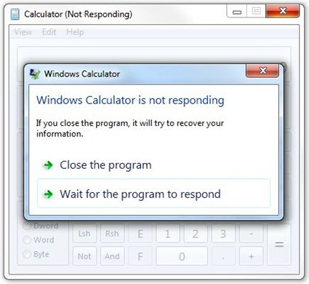
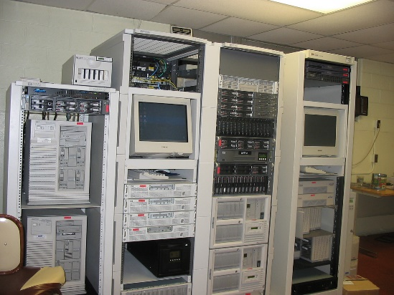

Kickin’ It Old School
The way it used to be
Client (Desktop)
Server (On-Premises)
Notes:
Client: Blocking UI threads. One program freezes, not a big deal.
Server: Extra-sized hardware, single DB backend (acting as bottleneck).
Synchronous code was OK for its time.

Slide 35
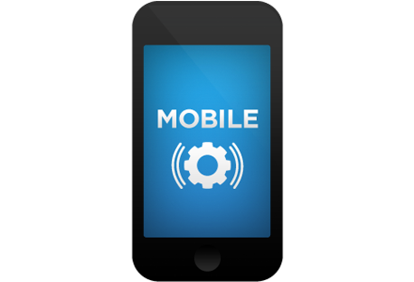
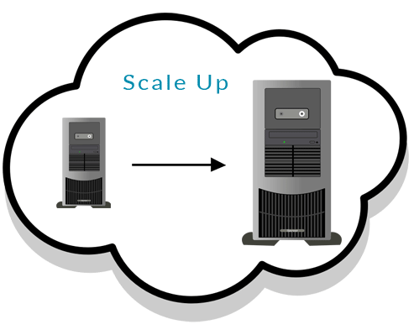

Diggin’ That Hip Asynchrony
The way of the future
Client (Mobile)
Server (Cloud)
Notes:
Client: Only one app! Can’t freeze it!
Benefit of asynchrony: responsiveness.
Server: Right-sized hardware, scalable backend.
Benefit of asynchrony: scalability, responsiveness to bursting traffic.
Cheaper hosting, better handling of sudden load.
Asynchronous code is quickly becoming a necessity in the modern mobile-first, cloud-first world.
We are living during a time of shift towards asynchronous code.

Slide 36
It Ain’t All Fly, Tho
The problem with asynchrony: it’s hard!
Hard to:
Reason about
Write code
Debug
Understand and maintain the code!

Slide 37
Async is Dyno-Mite!
Note: functional languages (with macros) do not need async/await as a language feature.
The entire purpose of async/await is to make asynchrony easier.

Slide 38
Summary So Far
Asynchrony is concurrency without threads.
Truly without threads. Not even OS or driver threads.
Benefits of asynchrony:
Responsiveness for clients (especially mobile).
Scalability for servers (especially cloud).
But asynchrony is hard. ☹
Languages are adopting async to make asynchrony easier.

Slide 39
Async as a Language Feature

Slide 40
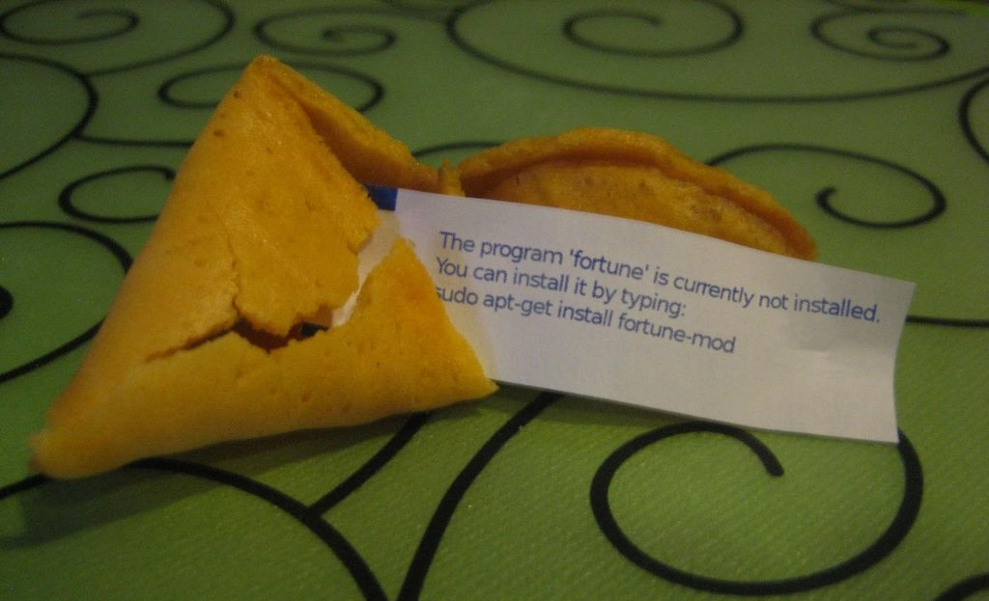
Today’s Fortune Cookie
To understand present, One must first understand past

Slide 41
Archaeology of Asynchrony
Async/Await
Futures / Continuations
Callbacks
Events
Time

Slide 42
Example Secret Sauce
Company Confidential
Our application will:
Download a string from teh internets
Save it to a database
Notes:
This is a simple example, because anything as complex as a real-world app would be totally overwhelming.
I’ll be using a made-up language that’s a cross between C# and JS.

Slide 43
Synchronous
string Download();
void Save(string);
void DownloadAndSave() {
string data = Download();
Save(data);
}
Notes:
Describes the secret sauce algorithm.
Actual application must be asynchronous.

Slide 44
Events
void Download();
event<string> DownloadCompleted;
void Save(string);
event<void> SaveCompleted;
Notes:
E.g., early .NET

Slide 45
Events
event<void> DownloadAndSaveCompleted;
void DownloadAndSave() {
DownloadCompleted += downloadResult => {
if (downloadResult.error) {
trigger DownloadAndSaveCompleted with downloadResult.error;
return;
}
SaveCompleted += saveResult => {
if (saveResult.error) {
trigger DownloadAndSaveCompleted with saveResult.error;
return;
}
trigger DownloadAndSaveCompleted;
};
Save(downloadResult.data);
};
Download();
}
Notes:
E.g., early .NET
Events indicate error or completion.

Slide 46
Events: Problems
Have to read code backwards.
Manual error handling.
Deep nesting.
Non-trivial logic (loops, joins) require manual state machines.
Notes:
In my experience, manual error handling is one of the primary sources of latent bugs.
You can clean a bit with multiple methods, but then your "download and save" logic is spread across 3 methods instead of 1.

Slide 47
Callbacks / CPS
void Download(callback<string>);
void Save(string, callback<void>);
void DownloadAndSave(callback<void> callback) {
Download(downloadResult => {
if (downloadResult.error) {
callback(error = downloadResult.error);
return;
}
Save(downloadResult.data, saveResult => {
if (saveResult.error) {
callback(error = saveResult.error);
return;
}
callback();
});
});
}
Notes:
E.g., Node.
Callbacks pass error or completion.

Slide 48
Callbacks / CPS: Problems
Have to read code backwards.
Manual error handling.
Deep nesting.
Non-trivial logic (loops, joins) require manual state machines.
Notes:
You can clean a bit with multiple methods, but then your "download and save" logic is spread across 3 methods instead of 1.

Slide 49
The Breakthrough: Futures
A “Future” represents a future value.
Futures complete exactly once, either with a value or with an error. Futures support continuations.
Futures are object representations of asynchronous operations.
Futures are monads.
Task<T>
Promise
Notes:
A Future is an object that gives you a “handle” for an asynchronous operation.
No more passing around raw callbacks or event handlers – the operation itself now has an object representation.

Slide 50

The Breakthrough: Futures
A “Future” can be anything…
File download
Database write
Timeout
“Join” of other futures
Mutual exclusion

Slide 51
Futures
Future<string> Download();
Future<void> Save(string);
Future<void> DownloadAndSave() {
return Download()
.then(data => { return Save(data); });
}
Notes:
E.g., ES2015.

Slide 52
Futures
Future<string> Download();
Future<void> Save(string);
Future<void> DownloadAndSave() {
return Download()
.then(data => { return Save(data); });
}
Future<void> DownloadAndSave() {
return Download()
.then(data => { return Save(data); })
.then(() => { return Log("done!"); });
}
Notes:
E.g., ES2015.
Allows “chaining” instead of nesting continuations.

Slide 53
Futures: Problems
Have to read code backwards.
Manual error handling.
Deep Shallow nesting.
Non-trivial logic (loops, joins) require manual state machines multiple methods with spread-out semantics.
Notes:
This is as far as libraries alone can take us.

Slide 54
Async
Future<string> Download();
Future<void> Save(string);
Future<void> DownloadAndSave() {
string data = await Download();
await Save(data);
}
Notes:
Up until now it’s all been libraries.
Async/Await is a language feature.

Slide 55
Synchronous
string Download();
void Save(string);
void DownloadAndSave() {
string data = Download();
Save(data);
}

Slide 56
Async: Problems
Have to read code backwards.
Manual error handling.
Deep nesting.
Non-trivial logic (loops, joins) require manual state machines.
Notes:
All logic can be represented naturally – in a style similar to the equivalent synchronous code.
No mangling necessary!

Slide 57
In Case You Just Woke Up
Asynchrony is concurrency without threads.
Truly without threads. Not even OS or driver threads.
Benefits of asynchrony:
Responsiveness for clients (especially mobile).
Scalability for servers (especially cloud).
But asynchrony is hard. ☹
Languages are adopting async to make asynchrony easier. ☺
Notes:
Is Async still an invasion? Or is it more of a revolution now?

Slide 58

Q&A
Go forth and be awesome!
Image from Etsy user Rosewine; used with permission
Notes:
Slides are available at StephenCleary.com

